Slide 1

Effects of mineral oils (DMSO extracts) on steroidogenesis
Jochem Louisse
Wageningen Food Safety Research (WFSR)
part of Wageningen University and Research (WUR)

Slide 2
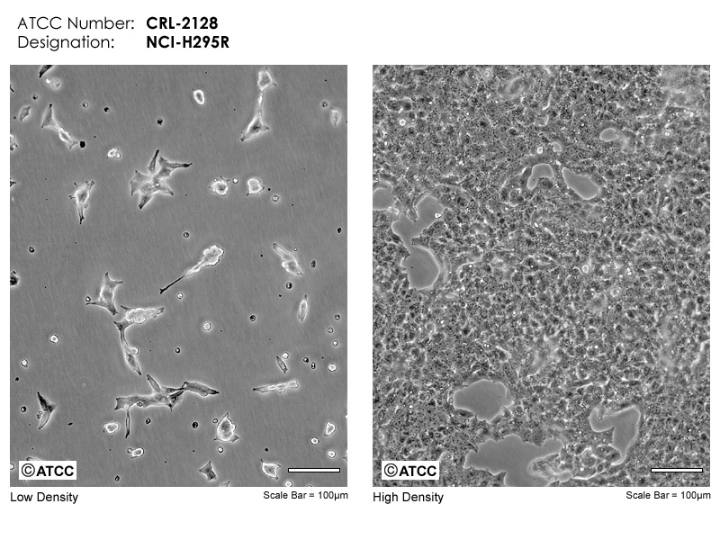
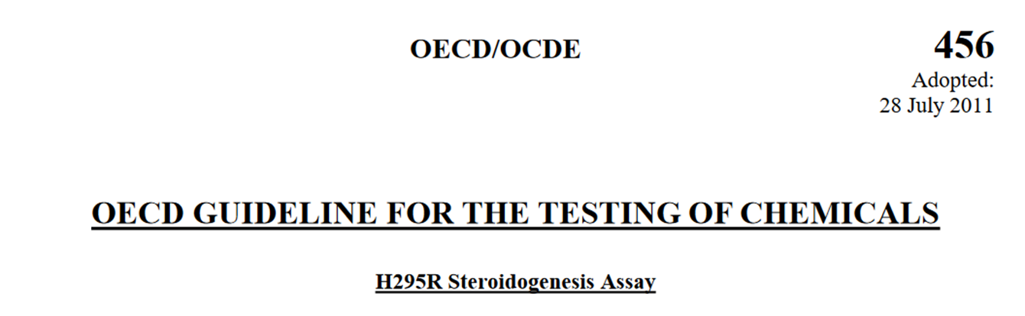
Cell based assays 3R-TOXFLOW
Chemicals that affect the endocrine system may have a negative impact on reproduction and development
Modulation of steroid hormone production by chemicals can be studied in vitro
  H295R cells (adrenocortical cell line)
OECD TG456
Two hormones
Estradiol (E2)
Testosterone (T)

Slide 3
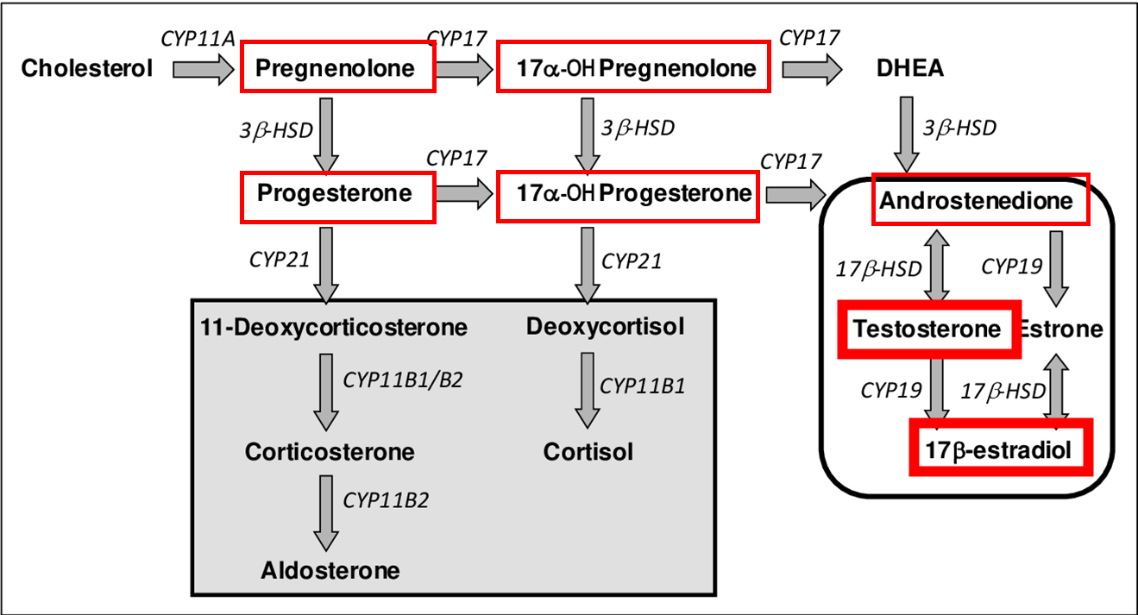
Steroidogenesis assay 3R-TOXFLOW
LC-MS-based quantification of hormones (based on Blokland et al., 2017)
Reference compounds
Prochloraz (E2: ↓, T: ↓)
Forskolin (E2: ↑, T: ↑)
Aminoglutethimide (E2: ↓, T: ↓)
Atrazin (E2: ↑, T: -/↑)
Bisphenol A (E2: ↑, T: ↓)
Mannitol: negative control
Test items:
8 mineral oils (DMSO extracts)
Extraction control

Slide 4
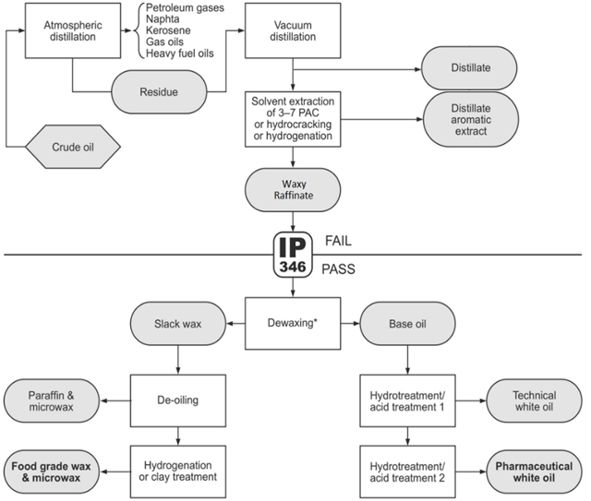
Test items
Petroleum-based Mineral Oils: DMSO extracts
Name Category CAS #
1. SN100-DIS: SN 100 Distillate UATO 64741-50-0
2. SN100-AE: SN100 Aromatic Extract DAE 64742-05-8
3. SN100-D-S: SN100 Distillate_S OLBO 64742-65-0
4. SN500-D-S: SN500 Distillate_S OLBO 64742-65-0
5. SN100-WR: SN100 Waxy Raffinate OLBO 64741-89-5
6. SN100-BO: SN100 Base Oil OLBO 64742-56-9
7. SN100-TWO: SN100 Technical White Oil HRBO 8042-47-5
8. SN100-MWO: SN100 Medicinal White Oil HRBO 8042-47-5

Slide 5
Screening test items
Positive controls
Test items
Log2 ratio treatment vs control
Log2 ratio treatment vs control
SN100-DIS and SN100-AE most potent mineral oils → concentration-response analysis

Slide 6
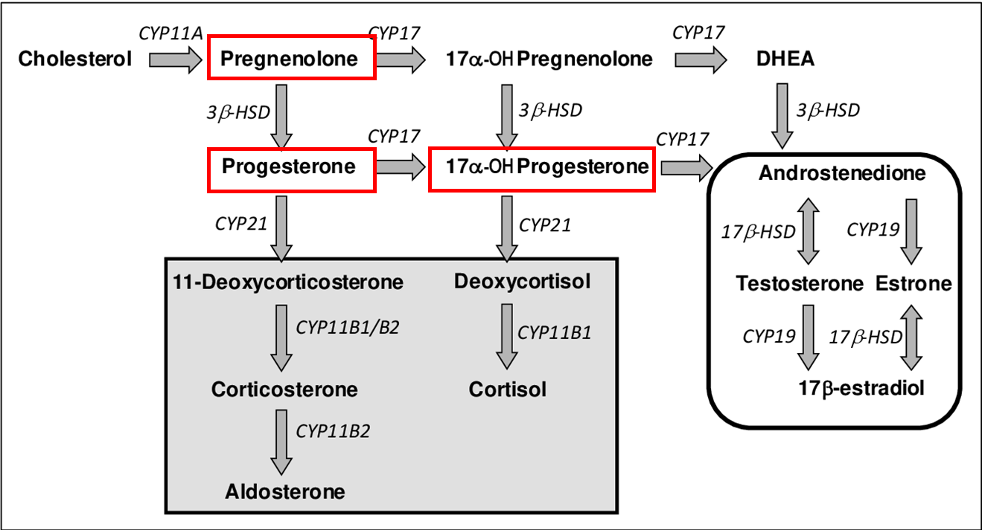
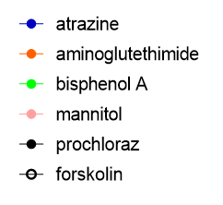

Concentration-response curves (1)
pregnenolone
progesterone
17α-OH-progesterone
hormone levels (% of solvent control)
10⁶
10⁵
10⁴
10⁶
10⁵
10⁴
10⁶
10⁵
10⁴
decrease
decrease
decrease

Slide 7
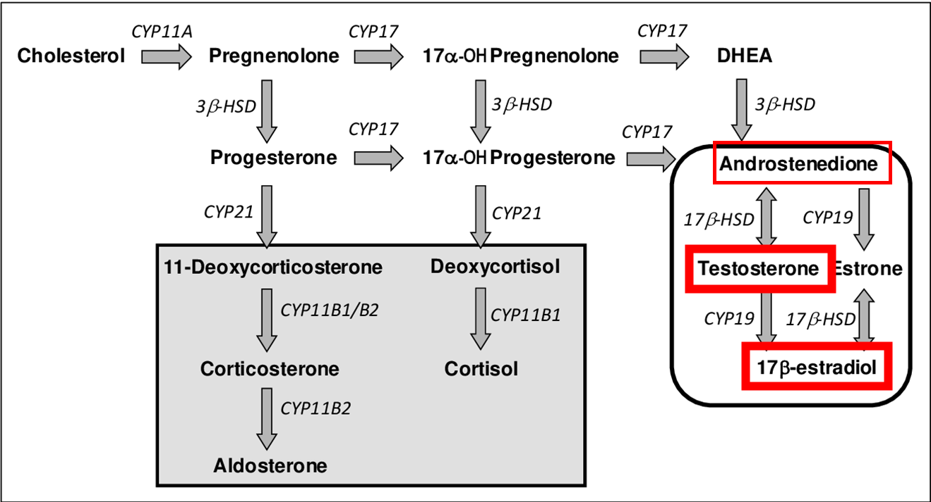
Concentration-response curves (2)
androstenedione
testosterone
estradiol
hormone levels (% of solvent control)
10⁶
10⁵
10⁴
10⁶
10⁵
10⁴
10⁶
10⁵
10⁴
decrease
decrease
increase

Slide 8
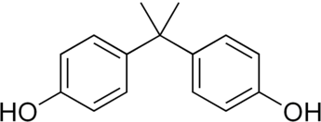
Overview main results in vitro assay
SN-100-DIS and SN-100-AE
Estradiol ↑
Testosterone ↓
Progesterone ↓
Effects mostly like reference chemical bisphenol A (BPA)
Wat about composition of mineral oil extracts? → characterization

Slide 9
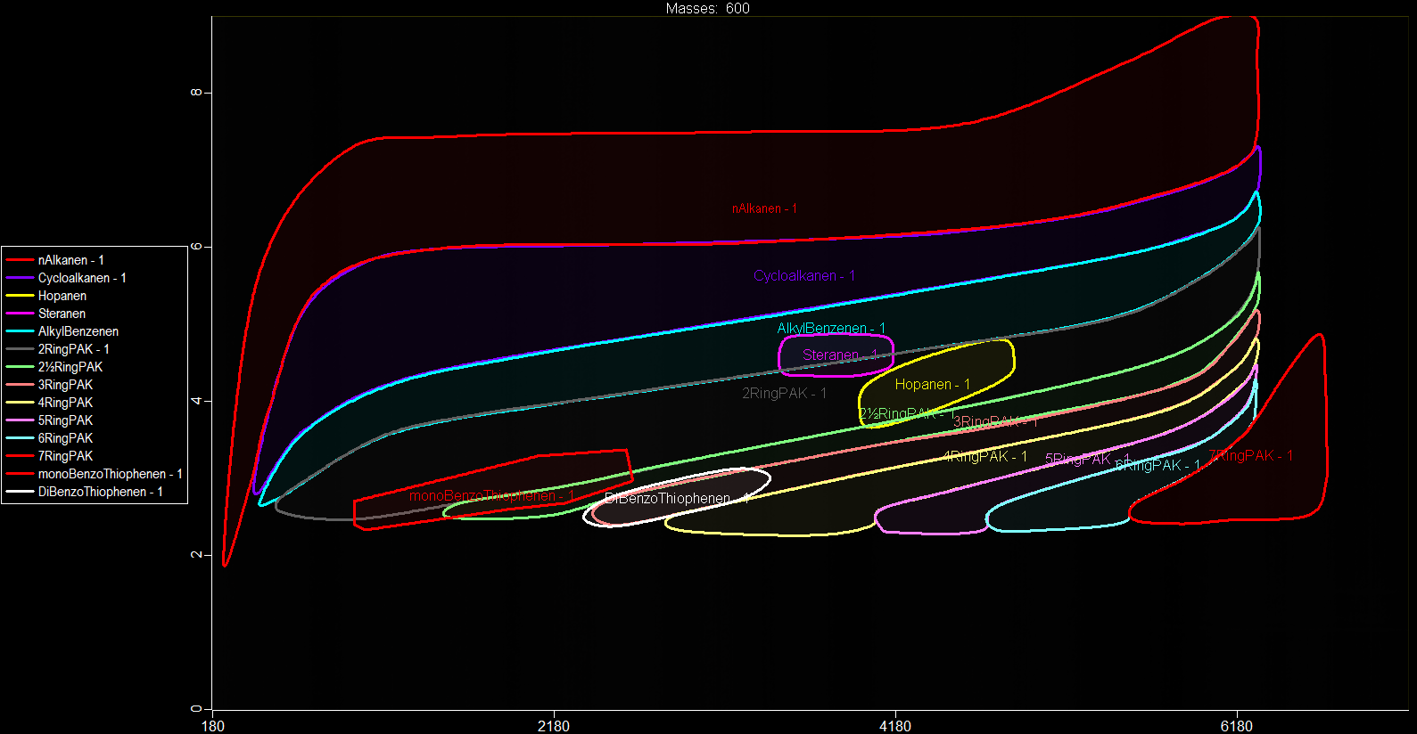
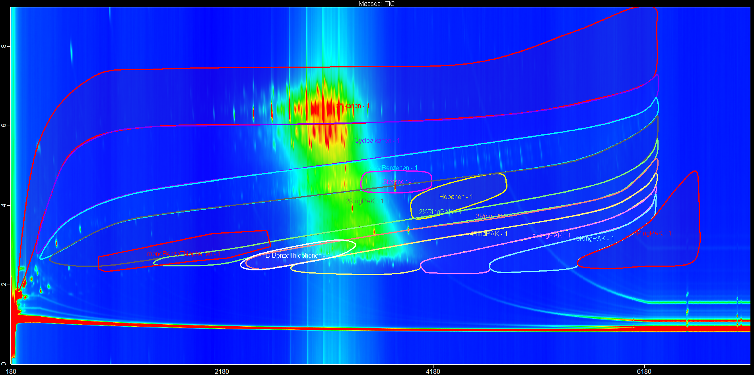
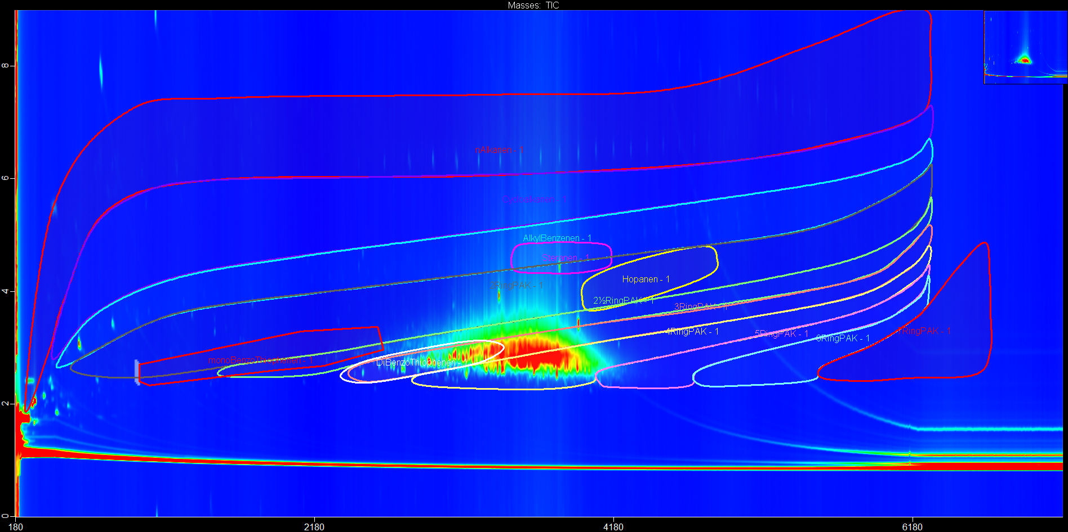
2D GC-TOF MS/MS
SN100-DIS oil
SN100-DIS DMSO extract
By testing DMSO-extract, we only test ‘part’ of the mineral oils

Slide 10
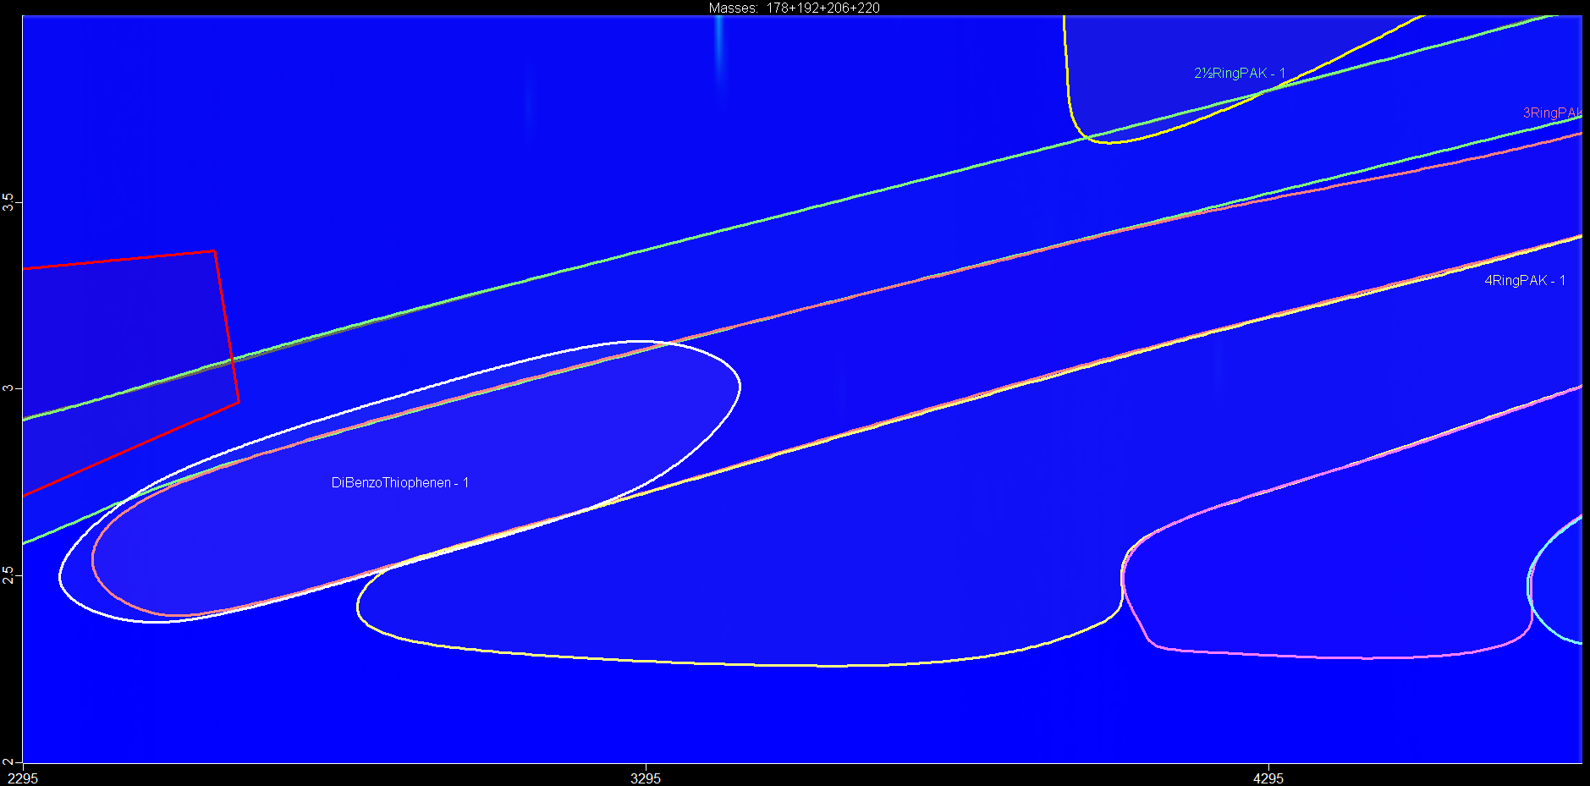
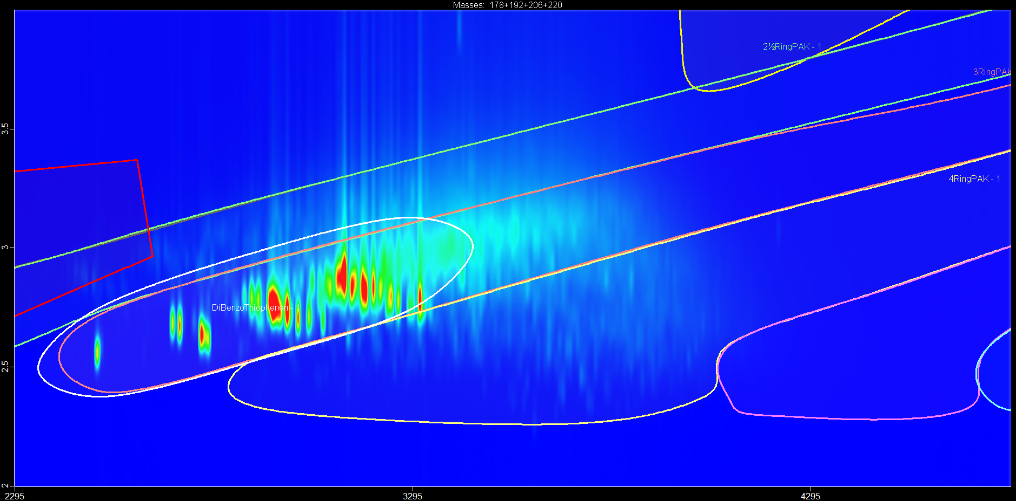
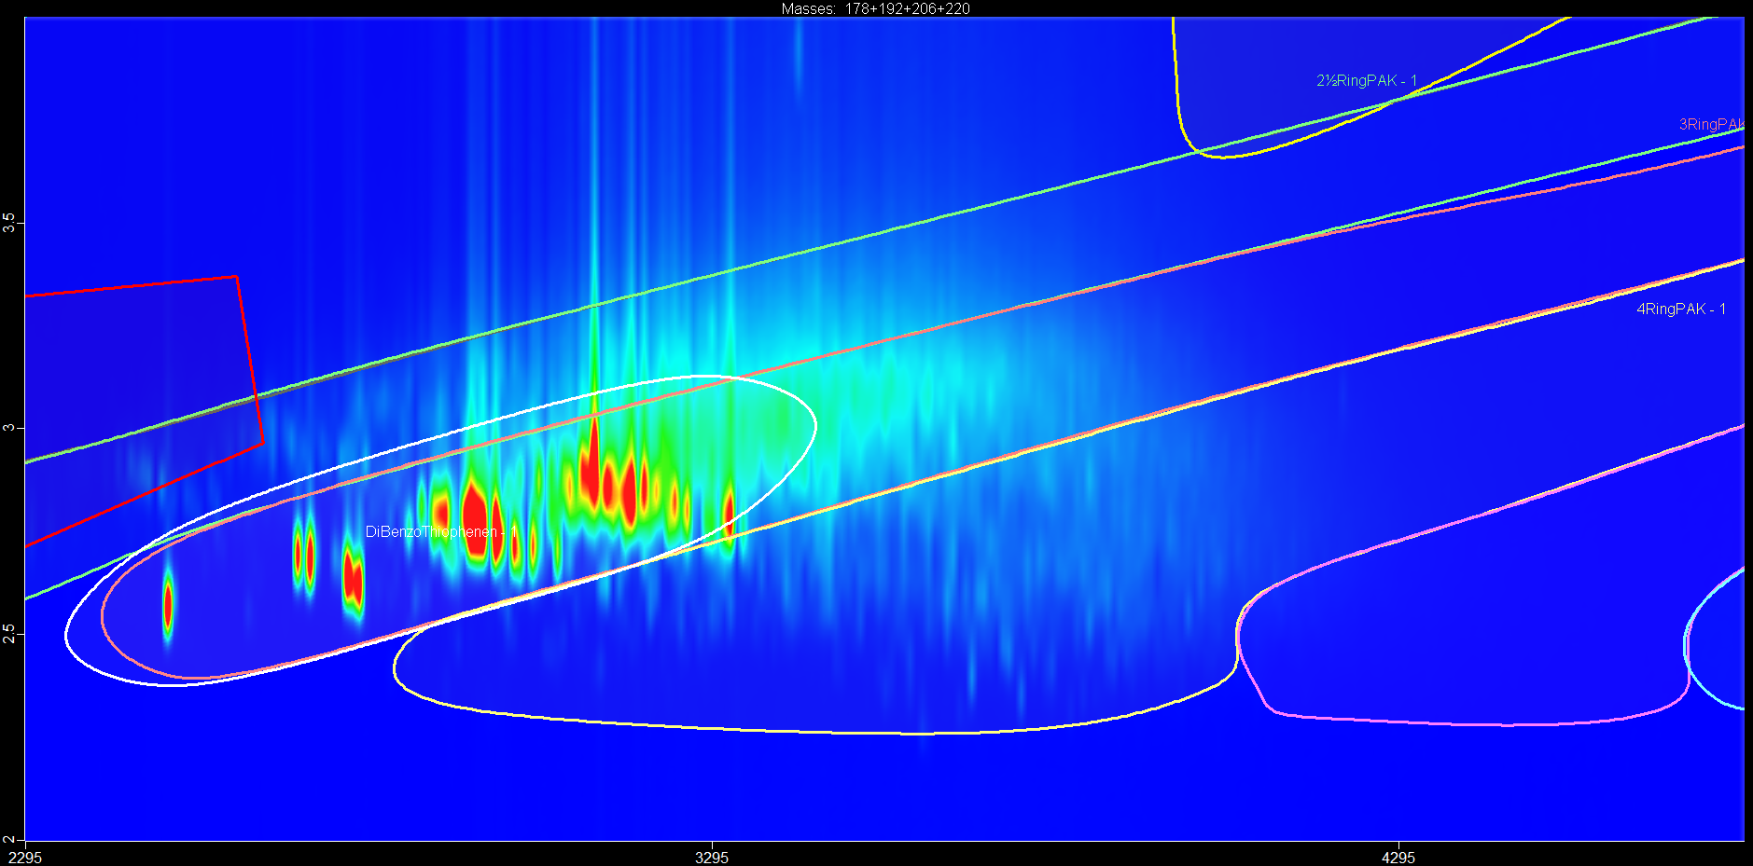
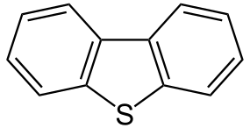
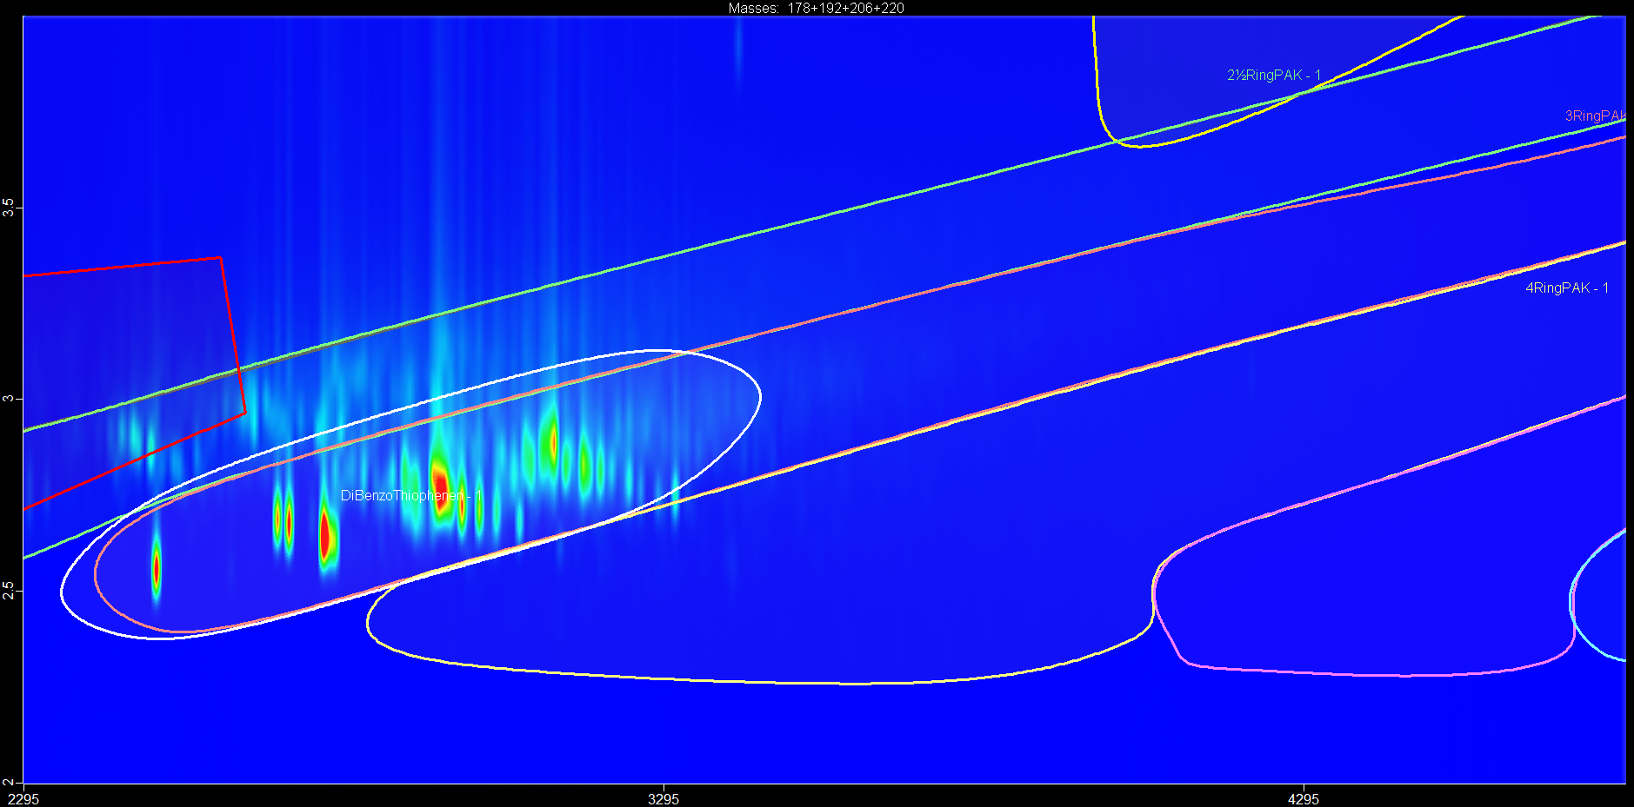
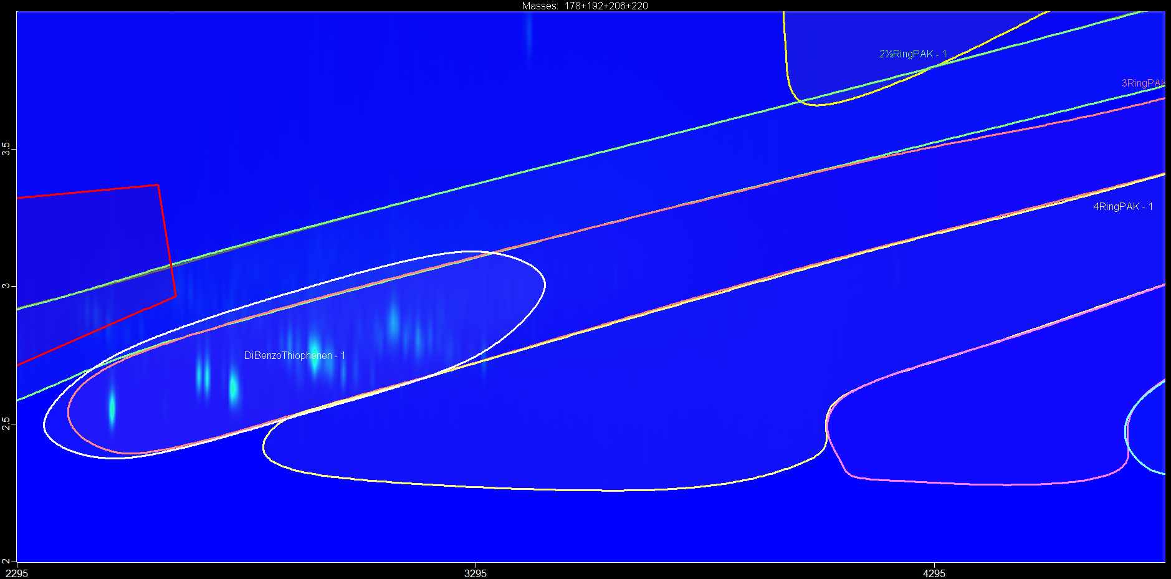
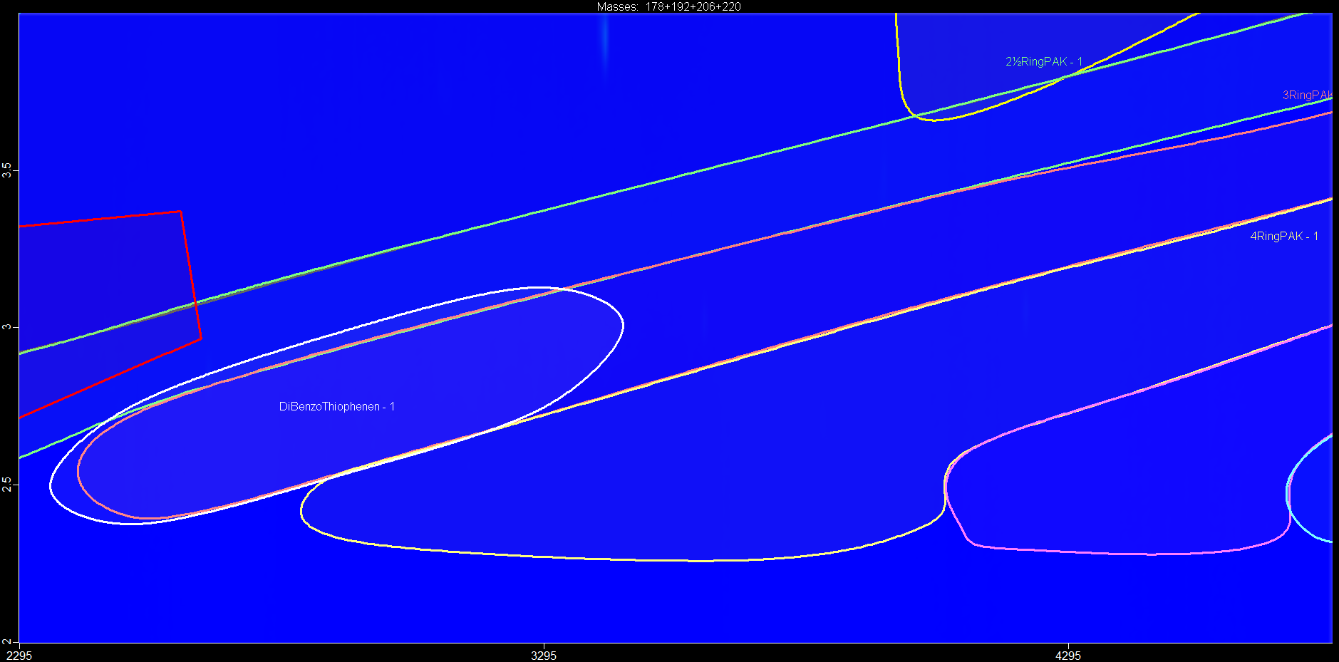
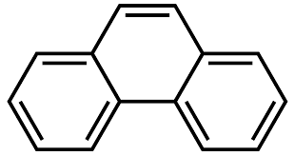
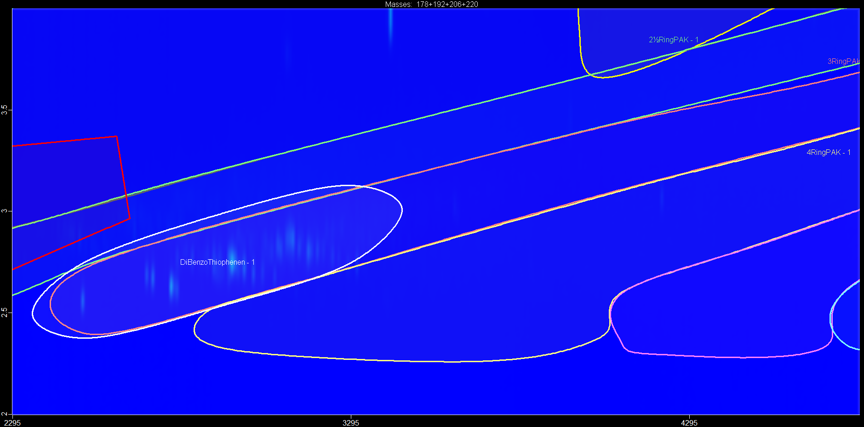
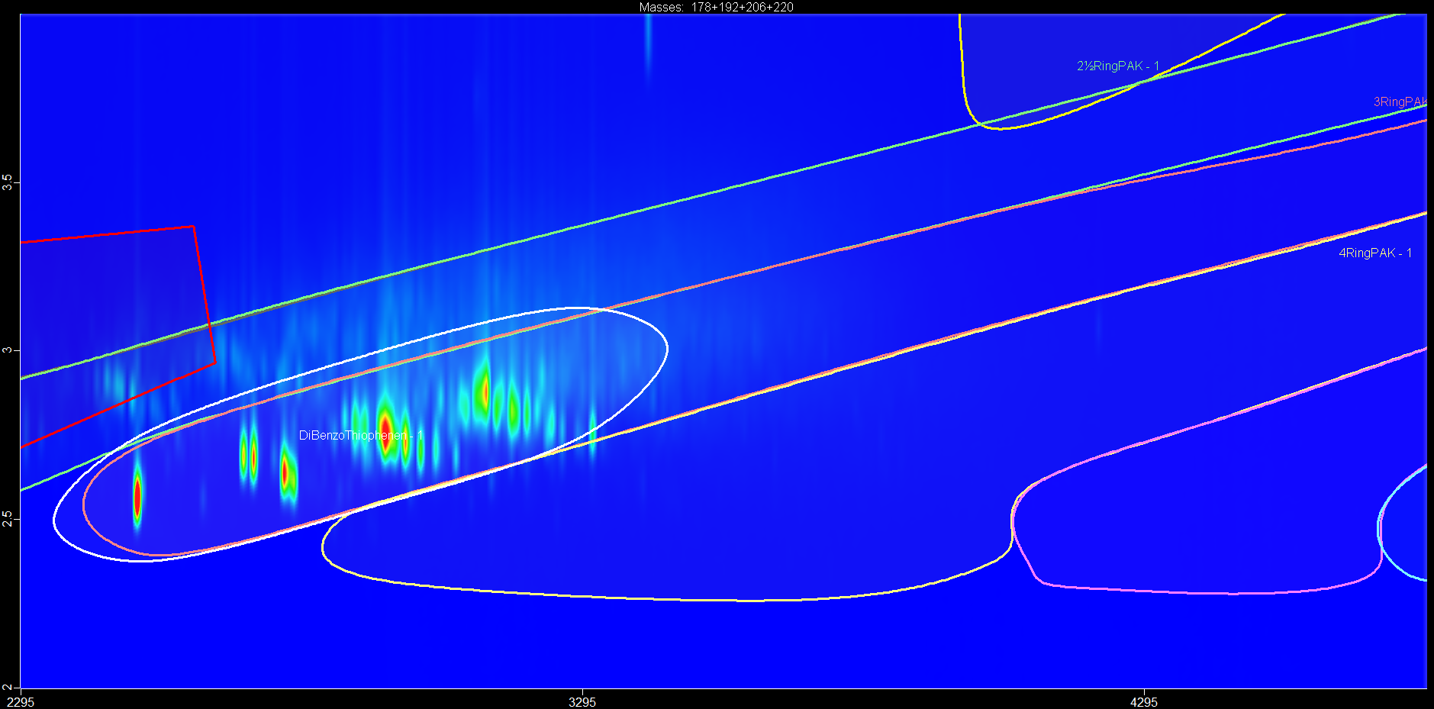
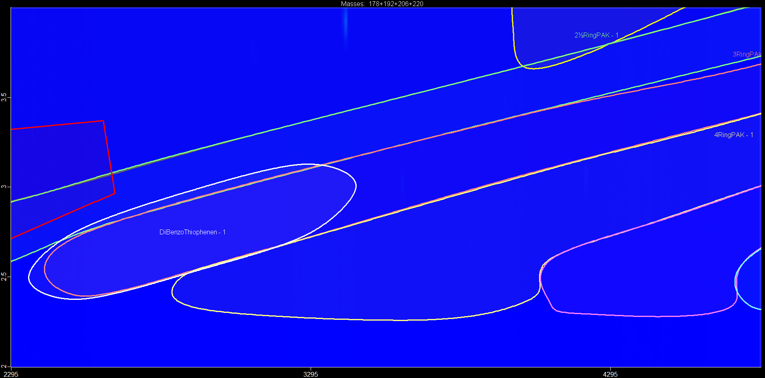
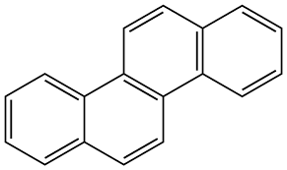
2D GC-TOF MS/MS results test items
extraction control
SN100-DIS
SN100-AE
BPA (reference item)
UATO
DAE
SN100-D-S
SN100-WR
SN100-TWO
dibenzothiophene
SN100-TWO
OLBO
OLBO
HRBO
phenanthrene
SN500-D-S
SN100-BO
SN100-MWO
OLBO
OLBO
HRBO
chrysene
Most potent test items contain highest concentrations of dibenzothiophenes and 3- to 4-ring PAHs

Slide 11
Conclusions
Mineral oil DMSO extracts were successfully tested in the H295R steroidogenesis assay.
SN100-DIS and SN100-AE extracts were most potent in modulating steroid hormone production.
Both extracts caused a concentration-dependent decrease of testosterone and androstenedione production.
Together with other test systems in the 3R-TOXFLOW test battery, the H295R assay provides important insights into the possible negative impact of test items on reproduction and development.

Slide 12
Acknowledgements
WU: Lenny Kamelia
Shell: Juan-Carlos Carrillo
WFSR: Dieke van Doorn, Marco Blokland, Willie Hijman, Guido van der Weg, Stefan van Leeuwen, Deborah Rijkers, Geert Stoopen, Ad Peijnenburg
EFRO
Ministry of Agriculture, Nature and Food Quality (KB-37-002-026)
3R-TOXFLOW consortium

